Slide 1


Enhancing Property Specification of Cyber-Physical Systems using Negative Selection
João Paulo Araujo
20/0099663

Slide 2
Índice
Introduction
Background
Cyber-Physical Systems
System Verification
Biological Immune System
Negative Selection Algorithm
Methodology
Innate Immunity through Assurances
Adaptive Immunity through learning
Related Work
Schedule

Slide 3

introduction

Slide 4
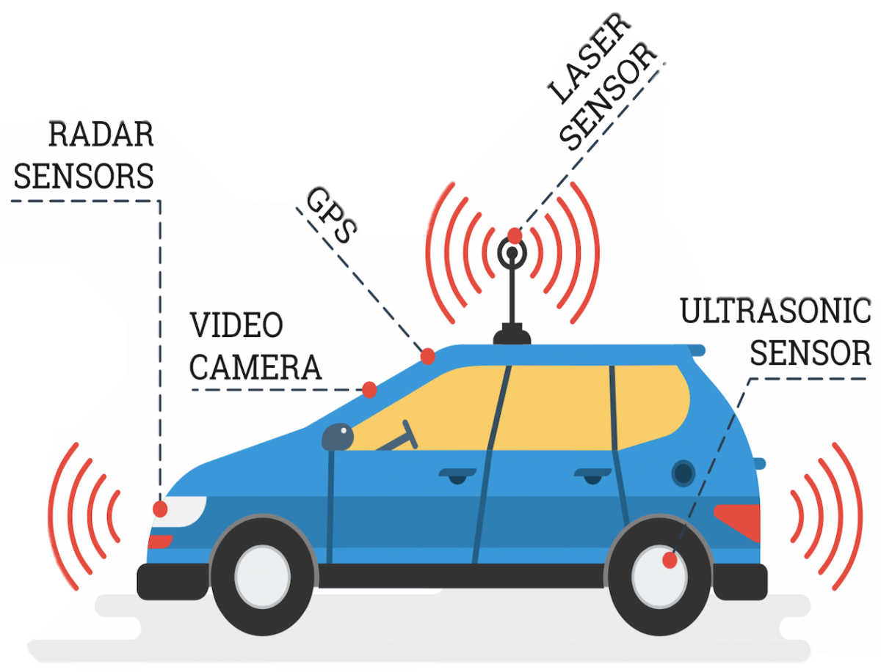
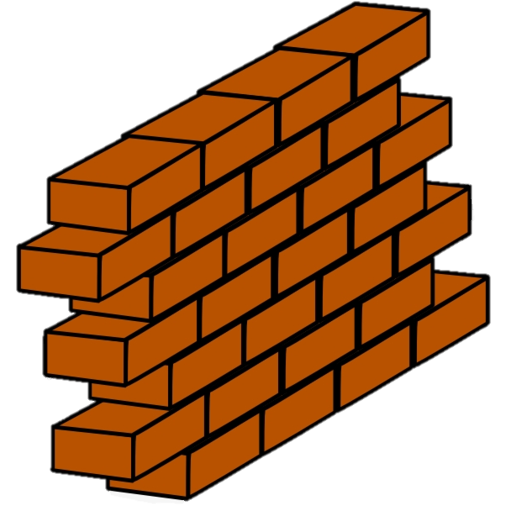
Motivation
Assurances are needed to guarantee the correct execution!
?
Almost impossible to anticipate the all the different scenarios
Cyber-physical System (CPS)
Notes:
That’s where Model Checking enters. Model Checking is a verification technique based on models that describe the possible system behavior in a mathematically precise and unambiguous manner. It uses brute-force to explore all possible system states when checking for properties, such as “the car must stop when it sees a wall”.
That is where our problem shows itself. When we have a very complex system, with lots of states and several properties to satisfy, we see that it requires more and more computation, but it does not require more than polynomial space to do so.

Slide 5
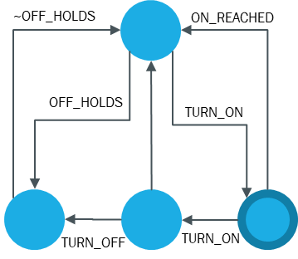

Motivation
Incomplete knowledge of the environment
The scale and complexity of CPS require compositional methods for integrated design and modeling.
Model Checking
Most CPS applications are built up from controlled sub-systems, systems-of-systems, with local interaction between physical systems and controllers affecting global performance.
System Model
$$¬φ→∅$$
Distributed sensing, actuation, and control needs to be modeled and simulated.
Property
The interfaces between the cyber and physical need to be identified and properties of the interfaces should be easy to specify.
New hybrid models may be needed to completely model all aspects of CPS.
Notes:
That’s where Model Checking enters. Model Checking is a verification technique based on models that describe the possible system behavior in a mathematically precise and unambiguous manner. It uses brute-force to explore all possible system states when checking for properties, such as “the car must stop when it sees a wall”.
That is where our problem shows itself. When we have a very complex system, with lots of states and several properties to satisfy, we see that it requires more and more computation, but it does not require more than polynomial space to do so.

Slide 6

Motivation
TURN_ON
TURN_OFF
$$¬φ→∅$$
TURN_OFF
TURN_ON
Property
Observador
TURN_OFF
ON_REACHED
~OFF_HOLDS
PROCESSSED_REACHED
OFF_REACHED
OFF_HOLDS
DETECTED_REACHED
OFF_REACHED
Notes:
That’s where Model Checking enters. Model Checking is a verification technique based on models that describe the possible system behavior in a mathematically precise and unambiguous manner. It uses brute-force to explore all possible system states when checking for properties, such as “the car must stop when it sees a wall”.
That is where our problem shows itself. When we have a very complex system, with lots of states and several properties to satisfy, we see that it requires more and more computation, but it does not require more than polynomial space to do so.

Slide 7
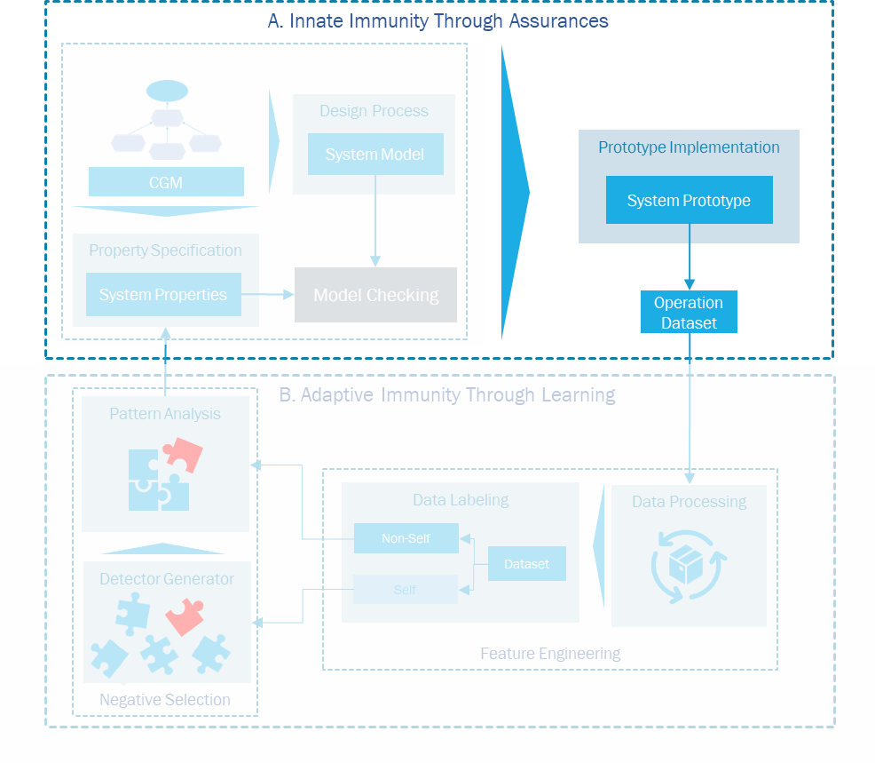
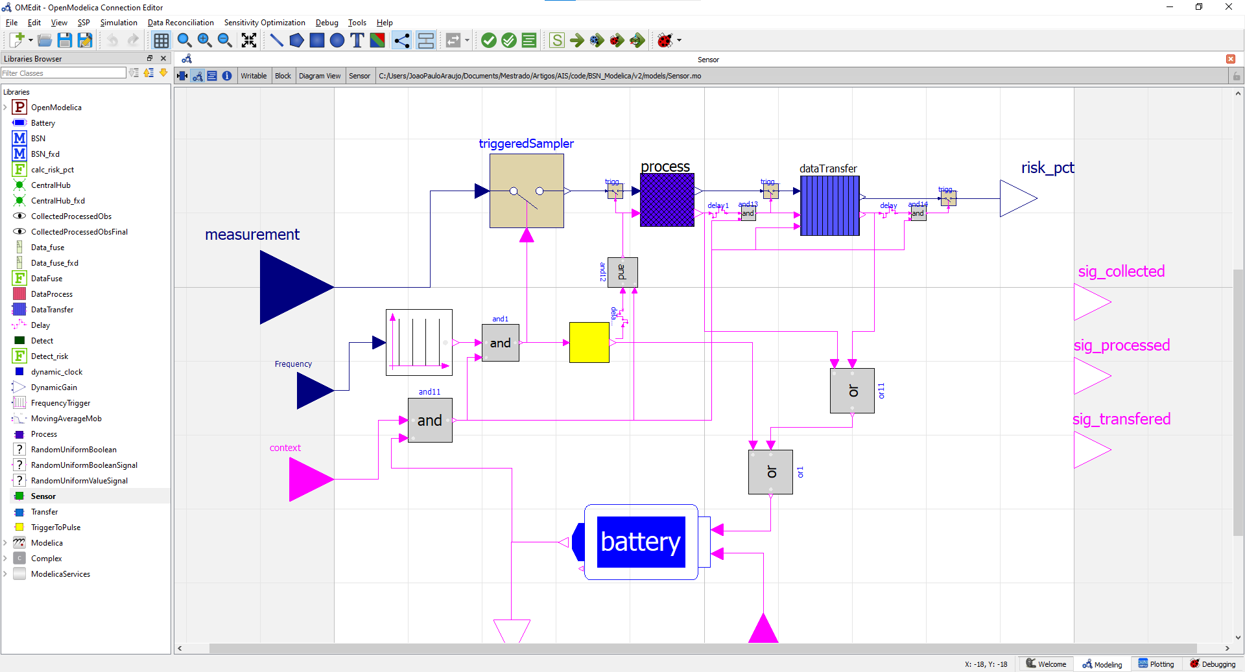
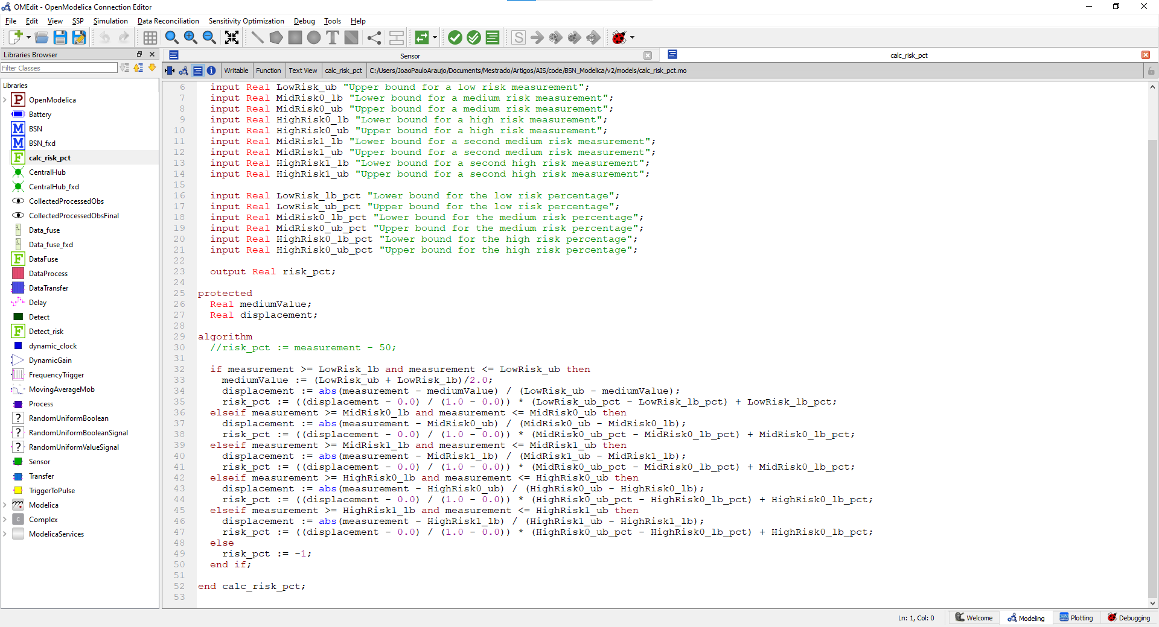
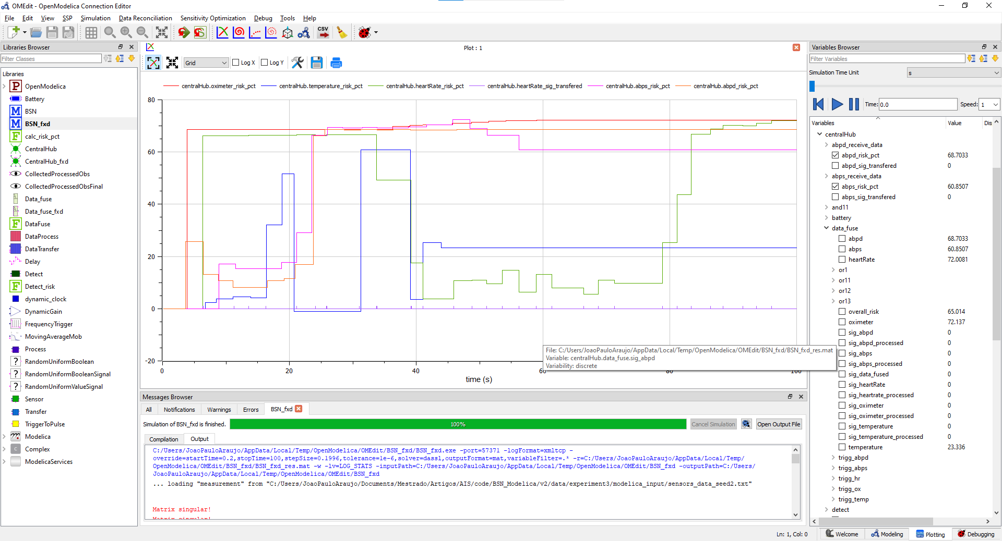


Motivation

Slide 8

Motivation
Notes:
That’s where Model Checking enters. Model Checking is a verification technique based on models that describe the possible system behavior in a mathematically precise and unambiguous manner. It uses brute-force to explore all possible system states when checking for properties, such as “the car must stop when it sees a wall”.
That is where our problem shows itself. When we have a very complex system, with lots of states and several properties to satisfy, we see that it requires more and more computation, but it does not require more than polynomial space to do so.

Slide 9
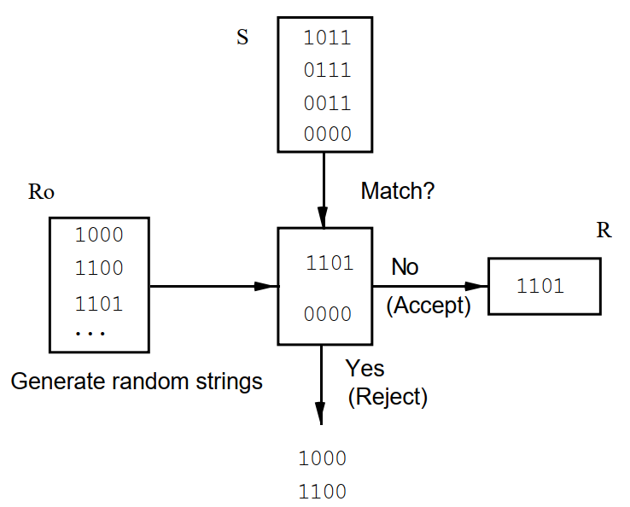
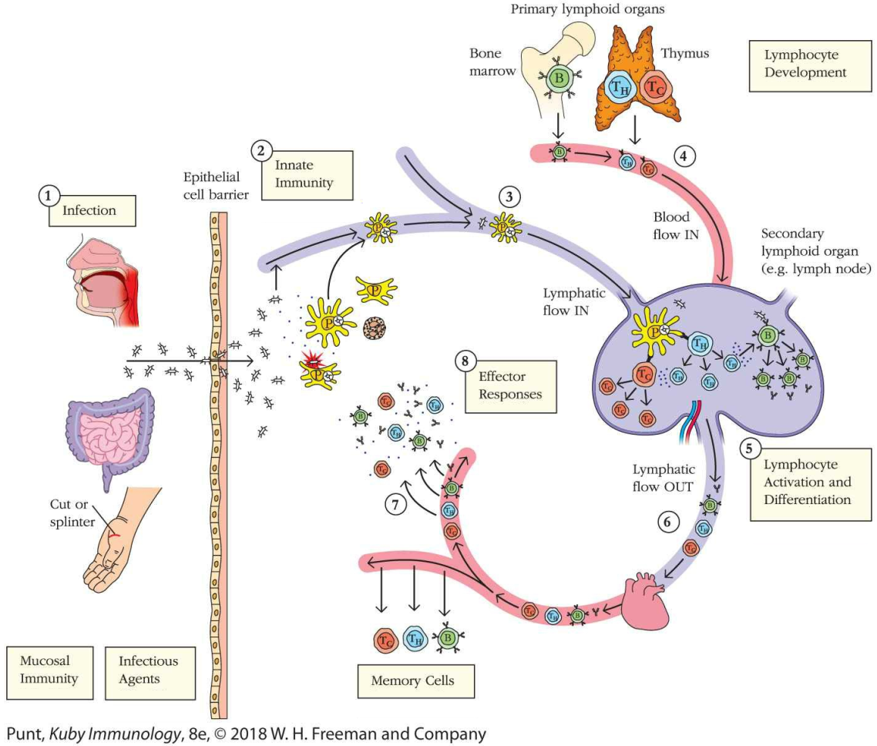
Motivation
Notes:
That’s where Model Checking enters. Model Checking is a verification technique based on models that describe the possible system behavior in a mathematically precise and unambiguous manner. It uses brute-force to explore all possible system states when checking for properties, such as “the car must stop when it sees a wall”.
That is where our problem shows itself. When we have a very complex system, with lots of states and several properties to satisfy, we see that it requires more and more computation, but it does not require more than polynomial space to do so.

Slide 10
Research Question
How to accurately enhance property specifications of CPS despite the complex interactions between its physical and cyber nature?
Notes:
That’s where Model Checking enters. Model Checking is a verification technique based on models that describe the possible system behavior in a mathematically precise and unambiguous manner. It uses brute-force to explore all possible system states when checking for properties, such as “the car must stop when it sees a wall”.
That is where our problem shows itself. When we have a very complex system, with lots of states and several properties to satisfy, we see that it requires more and more computation, but it does not require more than polynomial space to do so.

Slide 11
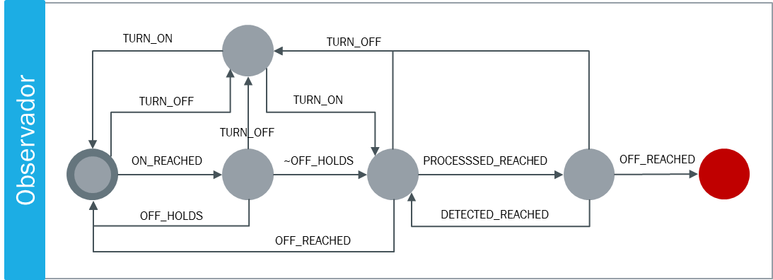
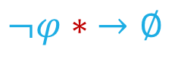
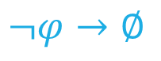
Overview
$$¬φ→∅$$
$$¬φ∗ →∅$$
Property
Property
Notes:
That’s where Model Checking enters. Model Checking is a verification technique based on models that describe the possible system behavior in a mathematically precise and unambiguous manner. It uses brute-force to explore all possible system states when checking for properties, such as “the car must stop when it sees a wall”.
That is where our problem shows itself. When we have a very complex system, with lots of states and several properties to satisfy, we see that it requires more and more computation, but it does not require more than polynomial space to do so.

Slide 12
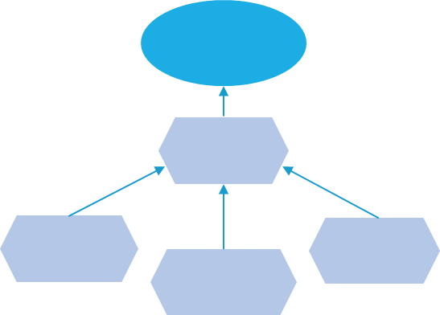


Overview
A. Innate Immunity Through Assurances
Design Process
System Model
Prototype Implementation
CGM
System Prototype
Property Specification
System Properties
Model Checking
Operation Dataset
B. Adaptive Immunity Through Learning
Negative Selection
Pattern Analysis
Feature Engineering
Data Labeling
Data Processing
Non-Self
Detector Generator
Dataset
Self

Slide 13

Background

Slide 14
Cyber-physical systems
Integrates physical processes and software components
Embedded computers and networks which are capable of monitoring and controlling physical processes, tipically with feedback loops, which affects the physical environment while they are operating
A CPS comprises three main modules [15]: a control unit, which relates to the computational aspect; a set of sensors and actuators, which refer to the physical processes and are controled by the control unit; and a collection of microcontrollers, which interfaces the two. Besides that, a communication interface is also required for the data exchange with other CPSs, a central unit or a cloud.
Automotive systems, avionics systems, defense systems, manufacturing systems, process control systems, traffic control systems, robotics, smart medical devices, smart household applications, and marine systems are just a few of the application areas
Complexity: The first, called structural complexity, refers to systems with many components and unexpected interactions between them. Next, the dynamic complexity occurs when it is difficult to understand how a system behaves and changes through time. Finally, the organizational complexity relates to the configuration of the team in charge of the complex system’s design and operation

Slide 15
System verification
Evidence to prove that the system is capable of meeting its requirements during its entire lifetime
Assurances: "the collection, analysis and synthesis of evidence for building arguments which demonstrate that the system satisfies its functional and non-functional requirements during operation“
Focuses on stablishing that the CPS satisfies certain properties
Prescribes what the system should and should not do.
Formal methods are considered by the state-of-the-art approaches

Slide 16
Model checking
A hybrid method that verifies if a property is satisfied by checking all the reachable states in the system
a timed-automata model of the system goes through a reachability analysis in order to verify the satisfiability of the properties
Three phases:
Modeling phase: the system is modeled according to its specification in terms of the description language of the tool that will run it.
Running phase: In this phase, the model checking tool is executed given the model and the properties to be verfied.
Analysis phase: After running the checker, if no violations are found, the process is concluded. If that is not the case, the cause of the result must be identified. It might be a modeling error or a property specification error. In both cases, upon making the required fixes, a new verification is required.

Slide 17
Runtime verification
A system-driven lightweight procedure that relies on gathering data from an active system to determine whether specific properties are being violated
observer automata, which have to be concretized for the property at hand. Particularly, new variables or communication actions are added to the system model, which are either referenced in the temporal logic formula to be verified or synchronized with an added observer automaton that monitors the system model during verification.

Slide 18
Modelica
Modelica is a mature industrial modeling language with multiple implementations, both proprietary and open source. Modelica aims to modeling and simulating cyber-physical systems, but it has also been used for automatically generating deployable (embedded) control software (C code) from models
Modelica is an acausal equation-based object-oriented modeling language for cyberphysical system modeling. In Modelica, behavior is described declaratively using mathematical equations and functions. Object-oriented concepts are used to encapsulate behavior and facilitate reuse of model components.
Modelica is superior to most other modeling formalisms due to the following important properties:
Object-oriented modeling
Acausal modeling: Modeling is based on equations instead of assignment statements as in traditional input/output block abstractions
Physical modeling of multiple domains : other techniques may require conversion to signal blocks
Hybrid modeling : Modeling of both discrete-time and continuous-time

Slide 19
Goal-oriented requirements engineering
One of the lenses through which these requirements can be seen is the stakeholder goals. Goal-Oriented Requirements Engineering (GORE) approach that follow a goal-oriented perspective and alludes to the usage of goals for every activity of the Requirements Engineering area and aims to acquire and represent systems and software requirements at the intentional level
"goals are objectives achieved by the system through cooperation of agents in the software-to-be and in the environment"

Slide 20
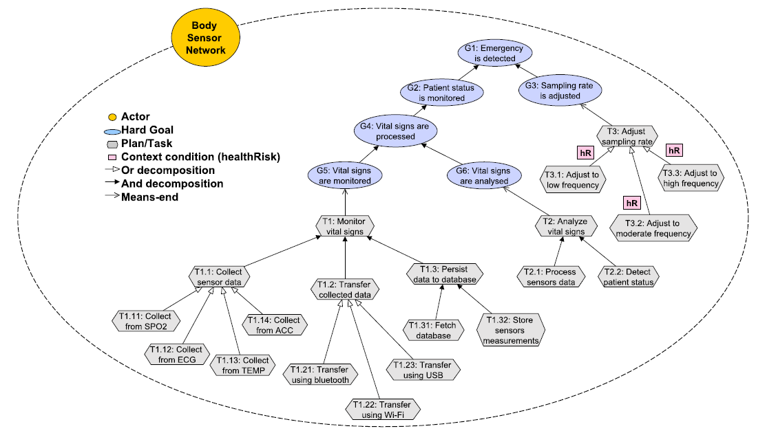
Goal-oriented requirements engineering
Seeks to capture the stakeholder’s intents behind the system specification
Goals
Contexts
Abstractions that represent the needs and expectations of the stakeholders
Partial states of the world that are relevant to the goal.
Actors: Humans or software that have goals and are capable of deciding autonomously how to reach them.
Tasks: Atomic parts responsible for the operationalization of a system goal
Elementary Properties of the system that are derived from the specification and need to be validated. The system is Only considered “correct” When it satisfies all Properties.
System Properties
Contextual Goal Model (CGM)

Slide 21
Biological immune system
The primary goal of the Biological Immune System (BIS) is to protect the body from potentially harmful material
Multilevel defense mechanism that is capable of distinguishing between molecules from the body itself and foreign ones, selecting a specific response to a threat, and enacting an inflammatory reaction in order to maintain the health and safety of the body.
The innate immunity is the body’s first line of defense. Inherited from the host’s progenitors, it is responsible for a quick or immediate response against infections. It is achieved through physical and chemical barriers or through cellular responses.
The cellular response, on the other hand, focus on perceiving the pathogens that were able to surpass the barriers and activating a variety of cellular responses, which include: the ingestion of the substance (phagocytosis), the induction of an inflammatory response and the triggering of the adaptive immunity for a tailor made response
The adaptive immunity is an immunological mechanism that is capable of "specifically recognize and selectively eliminate foreign microorganisms and molecules
it has a high level of specificity when dealing with the antigens,
he response can take days to be performed

Slide 22
Biological immune system

Slide 23
Negative selection algorithm
One of the fundamental skills of the BIS is the ability to differentiate between the body’s own cells and the foreign material. It is called self/nonself discrimination
T-cells are created in the bone marrow, where they have their receptors differentiated by a pseudo-random genetic rearrangement process. Later, in the Thymus, they are maturated by being tested with self cells. Lymphocytes that have a strong binding with self cells are discarded, in a censoring fashion. The result of the process is a set of diverse T cells specialized in binding with nonself cells
three aspects:
The goal is to identify the self-set counterpart.
Change/anomaly detection is performed by using some form of detector.
The algorithm makes use of only the self-samples during the detector generation

Slide 24
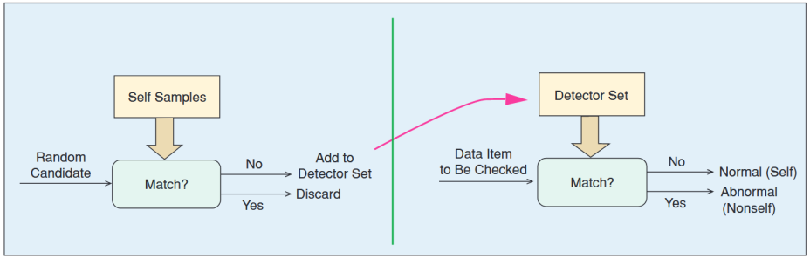
Negative selection algorithm

Slide 25
Negative selection algorithm
1
1
0
1
0
0
1
0
1
1
0
0
0
1
1
1
0
0
0
0
0
1
0
1
1
1
1
0
0
1
R-contiguous bits
r = 5
*
*
*
*
*
0
1
0
1
1
*
*
*
*
*
R-chunk
r = 5
1
0
0
0
0
0
1
0
1
1
1
1
0
0
1
Hamming Distance
1
1
0
1
0
0
1
0
1
1
0
0
0
1
1

Slide 26
Negative selection algorithm

Slide 27


Enhancing Property Specification of Cyber-Physical Systems using Negative Selection

Slide 28
Overview
A. Innate Immunity Through Assurances
Design Process
System Model
Prototype Implementation
CGM
System Prototype
Property Specification
System Properties
Model Checking
Operation Dataset
B. Adaptive Immunity Through Learning
Negative Selection
Pattern Analysis
Feature Engineering
Data Labeling
Data Processing
Non-Self
Detector Generator
Dataset
Self

Slide 29
A. Innate Immunity Through Assurances
A. Innate Immunity Through Assurances
Design Process
System Model
Prototype Implementation
CGM
System Prototype
Property Specification
System Properties
Model Checking
Operation Dataset
B. Adaptive Immunity Through Learning
Negative Selection
Pattern Analysis
Feature Engineering
Data Labeling
Data Processing
Non-Self
Detector Generator
Dataset
Self

Slide 30
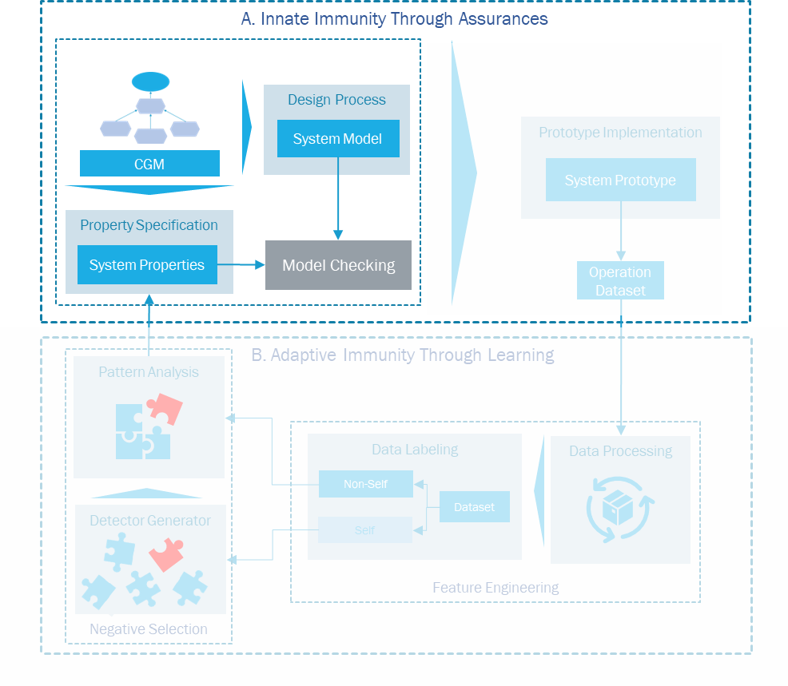
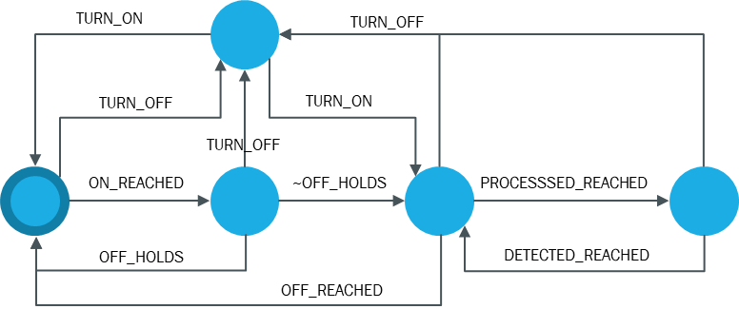
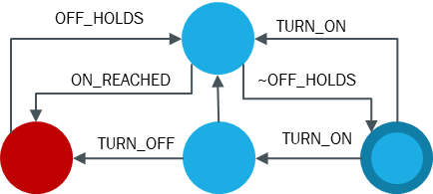
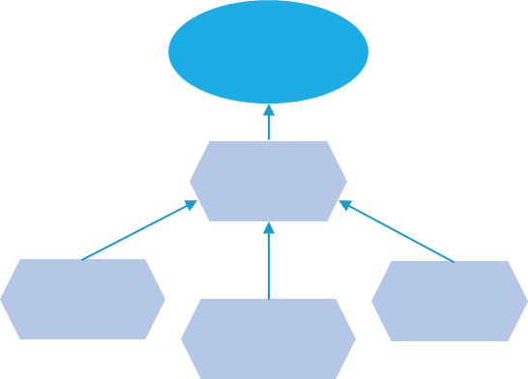

A. Innate Immunity Through Assurances
Observer
System Model
Model Checking
$$¬φ→∅$$
CGM
Property
Observer Catalog
PSP Catalog

Slide 31
Prototype Implementation

Slide 32
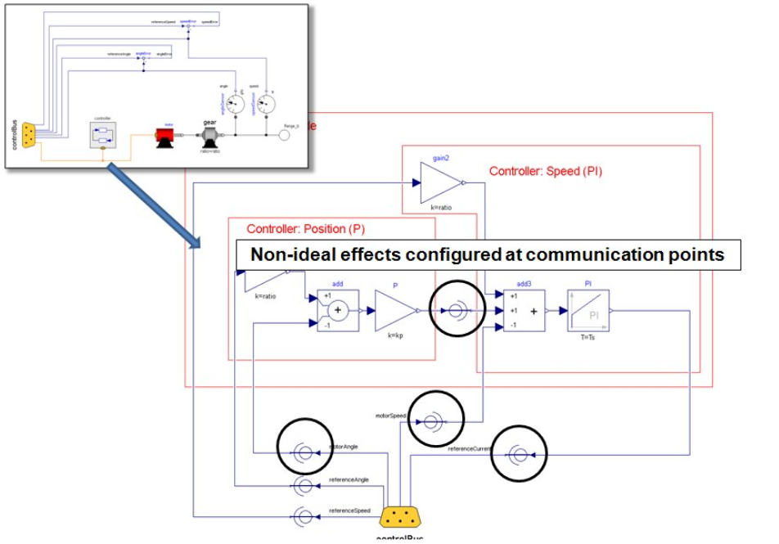
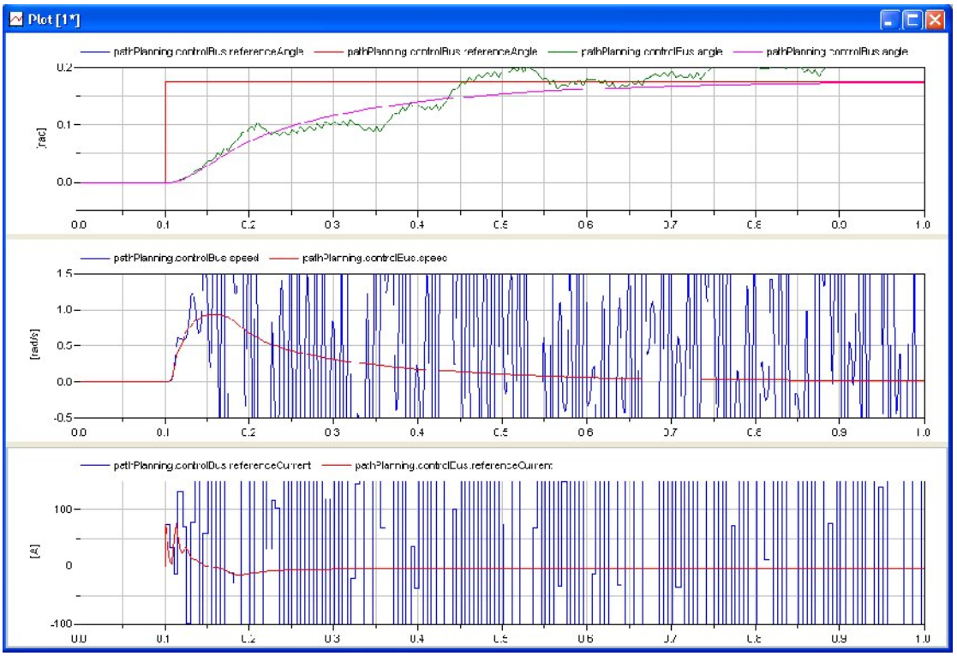
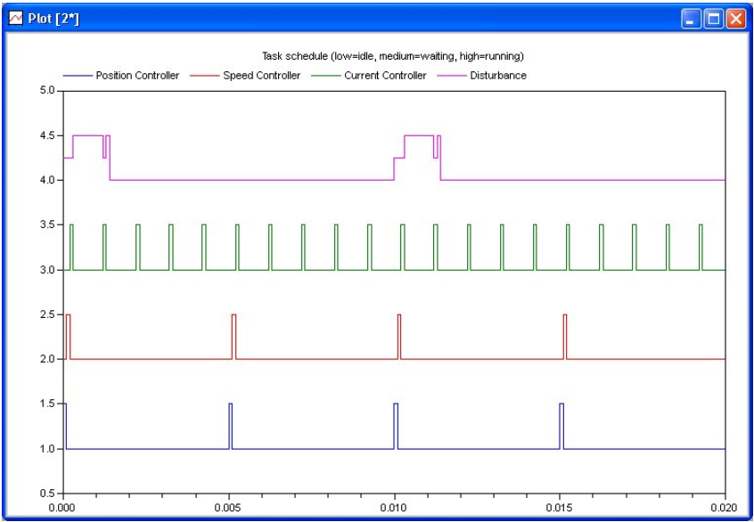
Prototype Implementation

Slide 33
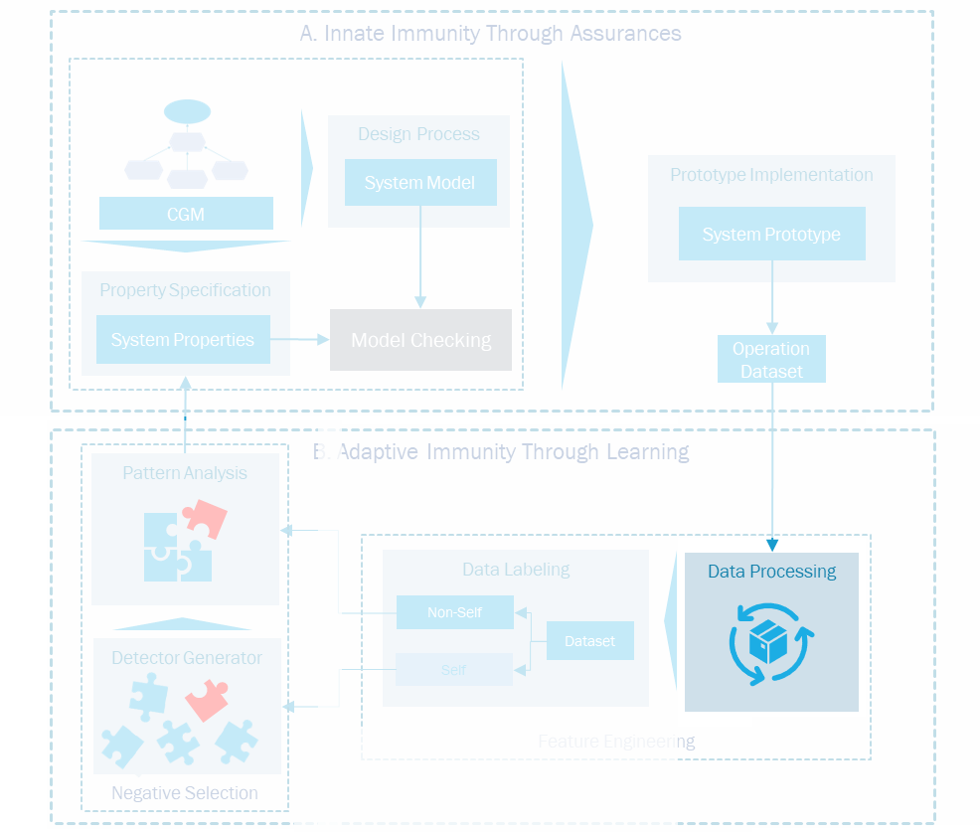
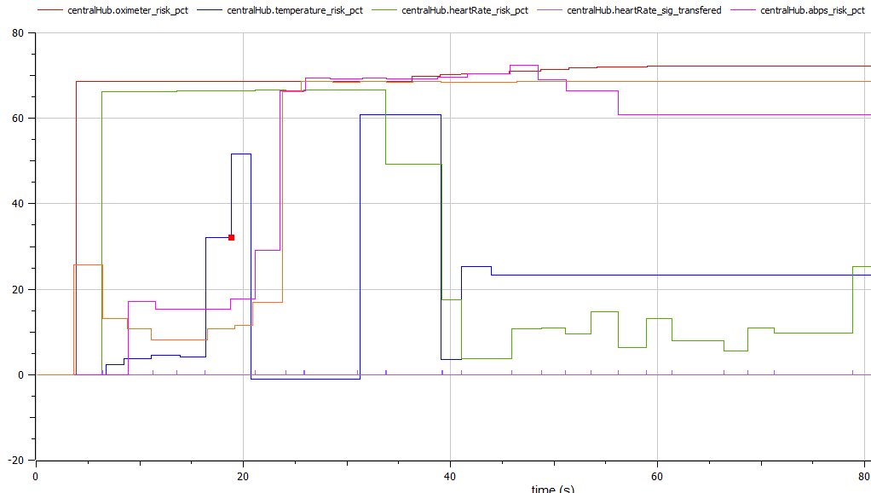
Prototype Implementation
Time | Context | Collected | Processed | Transfered | Central
0 | 1 | 0 | 0 | 0 | 0
0.5 | 1 | 1 | 0 | 0 | 0
1 | 1 | 0 | 1 | 0 | 0
1.5 | 1 | 0 | 0 | 0 | 0
2 | 0 | 0 | 0 | 1 | 0
2.5 | 1 | 0 | 0 | 0 | 1
3 | 1 | 0 | 0 | 0 | 0
3.5 | 1 | 1 | 0 | 0 | 0
4 | 0 | 0 | 0 | 0 | 0
4.5 | 1 | 0 | 1 | 0 | 0
5 | 1 | 0 | 0 | 0 | 0
5.5 | 1 | 0 | 0 | 0 | 1
6 | 1 | 1 | 0 | 0 | 0
Time | Context | Collected | Processed | Transfered | Central
0 | 1 | 0 | 0 | 0 | 0
0.5 | 1 | 1 | 0 | 0 | 0
1 | 1 | 0 | 1 | 0 | 0
1.5 | 1 | 0 | 0 | 0 | 0
2 | 0 | 0 | 0 | 1 | 0
2.5 | 1 | 0 | 0 | 0 | 1
3 | 1 | 0 | 0 | 0 | 0
3.5 | 1 | 1 | 0 | 0 | 0
4 | 0 | 0 | 0 | 0 | 0
4.5 | 1 | 0 | 1 | 0 | 0
5 | 1 | 0 | 0 | 0 | 0
5.5 | 1 | 0 | 0 | 0 | 1
6 | 1 | 1 | 0 | 0 | 0
Time | Context | Collected | Processed | Transfered | Central
0 | 1 | 0 | 0 | 0 | 0
0.5 | 1 | 1 | 0 | 0 | 0
1 | 1 | 0 | 1 | 0 | 0
1.5 | 1 | 0 | 0 | 0 | 0
2 | 0 | 0 | 0 | 1 | 0
2.5 | 1 | 0 | 0 | 0 | 1
3 | 1 | 0 | 0 | 0 | 0
3.5 | 1 | 1 | 0 | 0 | 0
4 | 0 | 0 | 0 | 0 | 0
4.5 | 1 | 0 | 1 | 0 | 0
5 | 1 | 0 | 0 | 0 | 0
5.5 | 1 | 0 | 0 | 0 | 1
6 | 1 | 1 | 0 | 0 | 0
Time | Context | Collected | Processed | Transfered | Central
0 | 1 | 0 | 0 | 0 | 0
0.5 | 1 | 1 | 0 | 0 | 0
1 | 1 | 0 | 1 | 0 | 0
1.5 | 1 | 0 | 0 | 0 | 0
2 | 0 | 0 | 0 | 1 | 0
2.5 | 1 | 0 | 0 | 0 | 1
3 | 1 | 0 | 0 | 0 | 0
3.5 | 1 | 1 | 0 | 0 | 0
4 | 0 | 0 | 0 | 0 | 0
4.5 | 1 | 0 | 1 | 0 | 0
5 | 1 | 0 | 0 | 0 | 0
5.5 | 1 | 0 | 0 | 0 | 1
6 | 1 | 1 | 0 | 0 | 0
Operation Dataset

Slide 34
B. Adaptive Immunity Through Learning
A. Innate Immunity Through Assurances
Design Process
System Model
Prototype Implementation
CGM
System Prototype
Property Specification
System Properties
Model Checking
Operation Dataset
B. Adaptive Immunity Through Learning
Negative Selection
Pattern Analysis
Feature Engineering
Data Labeling
Data Processing
Non-Self
Detector Generator
Dataset
Self

Slide 35
Data Processing
Time | Context | Collected | Processed | Transfered | Central_processed
0 | 1 | 0 | 0 | 0 | 0
0.5 | 1 | 1 | 0 | 0 | 0
1 | 1 | 0 | 1 | 0 | 0
1.5 | 1 | 0 | 0 | 0 | 0
2 | 0 | 0 | 0 | 1 | 0
2.5 | 1 | 0 | 0 | 0 | 1
3 | 1 | 0 | 0 | 0 | 0
3.5 | 1 | 1 | 0 | 0 | 0
4 | 0 | 0 | 0 | 0 | 0
4.5 | 1 | 0 | 1 | 0 | 0
5 | 1 | 0 | 0 | 0 | 0
5.5 | 1 | 0 | 0 | 0 | 1
6 | 1 | 1 | 0 | 0 | 0
0 | 1 | 0 | 0 | 0 | 0
P8
If the sensor collected some data, then the central node will process it.
Time restricted
T= 2s
Attribute Based
P8
If the sensor collected some data, then, in 2 seconds, the central node will process it.
3.5 | 1 | 1 | 0 | 0 | 0
4 | 0 | 0 | 0 | 0 | 0
4.5 | 1 | 0 | 1 | 0 | 0
5 | 1 | 0 | 0 | 0 | 0
5.5 | 1 | 0 | 0 | 0 | 1
6 | 1 | 1 | 0 | 0 | 0
Next Segment

Slide 36
Data Processing
Time | Context | Collected | Processed | Transfered | Central_processed
0 | 1 | 0 | 0 | 0 | 0
0.5 | 1 | 1 | 0 | 0 | 0
1 | 1 | 0 | 1 | 0 | 0
1.5 | 1 | 0 | 0 | 0 | 0
2 | 0 | 0 | 0 | 1 | 0
2.5 | 1 | 0 | 0 | 0 | 1
3 | 1 | 0 | 0 | 0 | 0
3.5 | 1 | 1 | 0 | 0 | 0
Was it present at all times?
Segment Number | Sensor Collected | Sensor Processed | Sensor Transfered | Central node Processed | Context Always present | Time between process and transfer | Time until Central Node processed
1
1
1
1
1
0
0
0.5
null

Slide 37
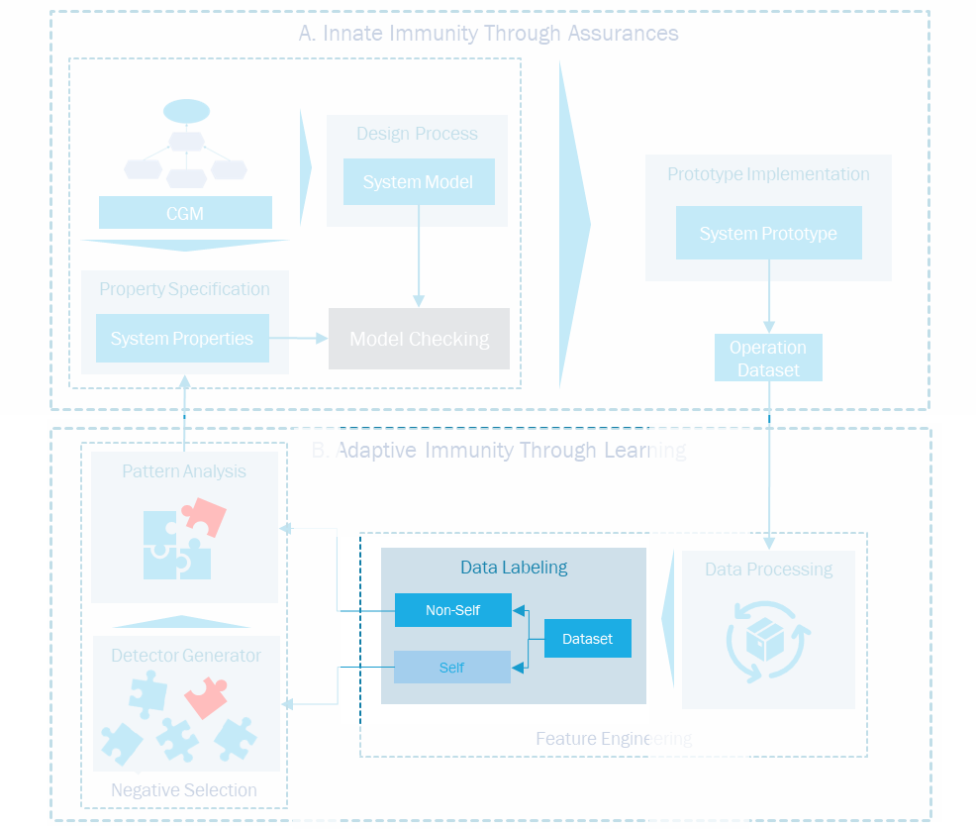
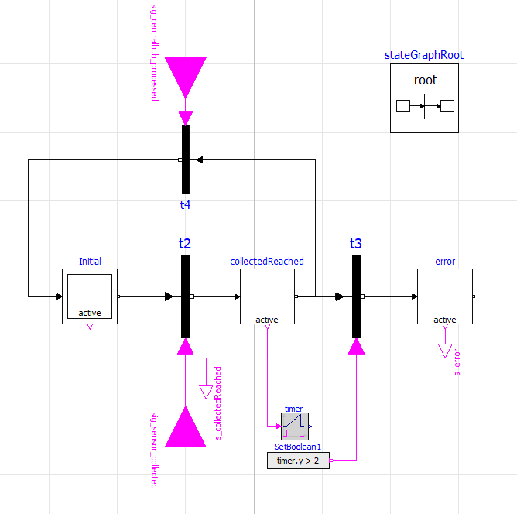
Data labeling
Central node Processed
Sensor Collected
Timer
Segment Number | Sensor Collected | Sensor Processed | Sensor Transfered | Central node Processed | Context Always present | Time between process and transfer | Time until Central Node processed
1
Label
1
1
1
1
0
0
0.5
null
1

Slide 38
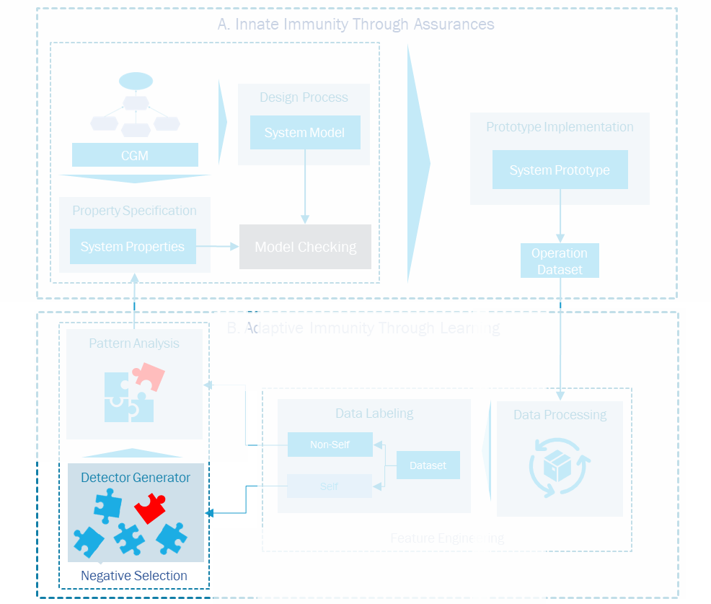
Exploratory data analysis
Missing Data
Correlation
Context Always present
0.8465
Sensor Transfered
-0.6488
Data types
Sensor Collected
-0.5544
Central Node Processed
0.5312
Sensor Processed
0.3144
Threshold
Behavior
0.1797
Emergency detected
Central Node Persisted
-0.0655

Slide 39
String Formatting
Context Always present | Transfered | Collected | Central Node processed | Processed
0 | 1 | 1 | 0 | 1
Label
1
0
1
1
0
1
Nonself

Slide 40
Train-test split
Train
Test
Nonself
Self
Test
How does the model generalize?
Property Violations
Regular Execution

Slide 41

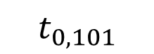
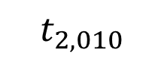
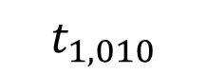
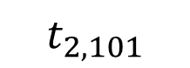


Detector Generation
Self-set
0
1
1
1
1
1
1
0
1
0
0
0
1
1
1
0
1
0
0
1
Match?
No, accept!
$$t_{1, 010}$$
$$t_{2, 010}$$
0
1
0
0
0
1
1
1
$$t_{2, 101}$$
$$t_{0, 101}$$
1
0
1
*
0
1
0
*
Detectors
Candidate Detectors
Yes, discard!
$$t_{0, 010}$$
$$t_{1, 101}$$

Slide 42
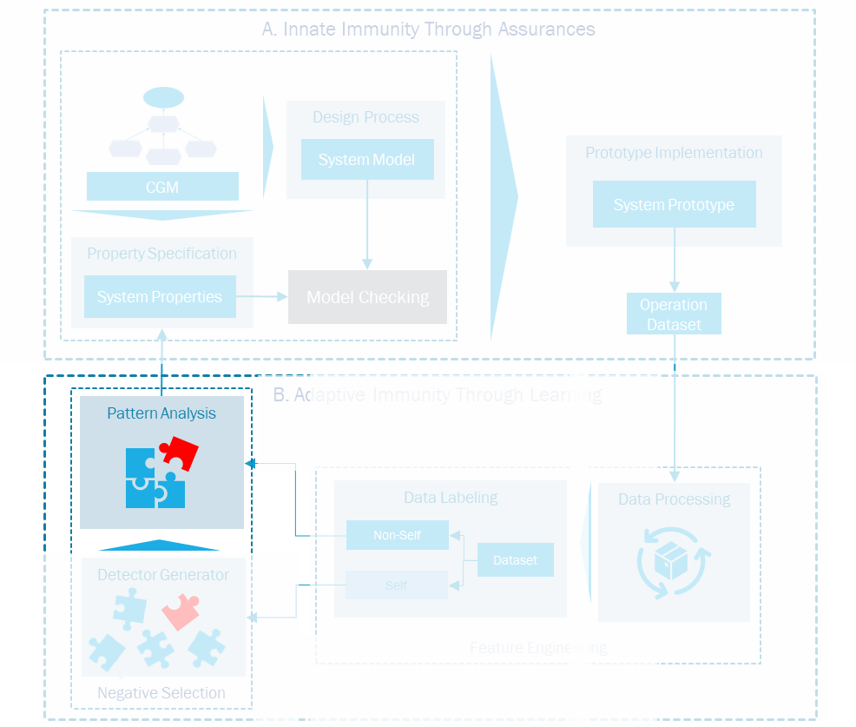
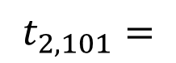
Pattern analysis
Position | Feature
0 | Context Always present
1 | Transfered
2 | Collected
3 | Central Node processed
4 | Processed
$$t_{2, 101}=$$
1
0
1

Slide 43

Related work

Slide 44
Verification Methods in Cyber-Physical Systems
Representing both the cyber and physical aspects of any CPS challenges the task of modeling such systems, since we are combining discrete and continuous models. Aside from the complexity of representing the real environment, a CPS has only a limited understanding of its surroundings.
Akella et al., for instance, addresses this problem by trying to simplify the physical model. This was done by discretizing the events that cause flow change and to representint the CPS as a deterministic state model with discrete flow values inside its physical components. Model checking is then utilized to formally test insecure interactions between all conceivable behaviors of the specified CPS.
Botaschanjan et al. provide a sucessfull attempt to close this gap in automotive systems by combining the model checking verification of the lower layers of the system with the simulation of the upper layers

Slide 45
Verification Methods in Cyber-Physical Systems
Formal methods in anomaly detection.
Jones et al. uses formal methods to an anomaly detection framework to determine whether or not a particular CPS is under attack.
They build STL properties based on the normal behavior of the system and flag the abnormal behavior.
Then, a one-class SVM model is used to detect deviations.
Our approach share some similarities with Jones’. Nonself data, i.e. anomalies, are flagged according to system properties and a one-class machine learning algorithm (NSA) is performed to understand the patterns based on the self data. Although in our work the properties are specified by the stakeholders and undergo a process of formalism. Besides that, we leverage the detectors generated to gain insight on the violations, which is used to enhance the specification. Webster [51] also integrates model checking and simulation in order to ensure safe operations for autonomous unmanned aircrafts. They argue that the high level of assurance provided by the formal method would increase the accuracy of the simulation model

Slide 46
Fault Analysis and the Negative Selection
NSA in manufacturing settings:
Govender and Mensah
Minimize the production lossess related to equipment malfuctioning.
Simulation of an automobile hub pressing machine using Matlab
programmable logic controller (PLC) connected to sensors, switches and safety curtains, and a module hosting the AIS.
Self-set training data comes from the execution of the system under error free operations
Represented in the Hamming space as binary strings.
Nonself detectors are randomly generated in the censoring phase of the algorithm by using the Hamming distance for the comparisons.
Finally, the detectors are used in runtime to determine the anomalies in a hierachical fashion.
They state that the representation of the data as binary strings allow for the reverse map of the resulting detectors back into the real nature of the equipment, even though the paper does not further explore this aspect.

Slide 47
Fault Analysis and the Negative Selection
NSA for diagnosis of Wind Turbine defect:
Alizadeh et al.
Wind turbine defect diagnostic system that relies on real-valued NSA to boost nonself-space coverage.
V-detectors are used for representing the detectors,
The Euclidean distance is utilized for matching, and data are represented as spheres.
The detection phase proceeds as default,
The isolation phase relies on the training of new instances of the NSA for each pre-defined fault, which are employed in a hierarchical manner to better describe identified faults.
NSA for diagnosis o CPS’ fault:
Ren et al.
V-detectors are created in such a way that the detector’s coverage is increased while the overlap is reduced.
The detection phase contains no surprises,
The isolation phase relies on an algorithm that attempts to match the defect at hand with a collection of pre-identified fault representatives

Slide 48
Fault Analysis and the Negative Selection
NSA for diagnosis o CPS’ fault:
Ren et al.
V-detectors are created in such a way that the detector’s coverage is increased while the overlap is reduced.
The detection phase contains no surprises,
The isolation phase relies on an algorithm that attempts to match the defect at hand with a collection of pre-identified fault representatives

Slide 49
Fault Analysis and the Negative Selection
Theodore – Trace checker for CPS properties:

Slide 50

Schedule

